Slide 1

Machine Learning
Practical Presentation
Muhammad Faisal Kamran 2023-BS-AI-025 4th A
01

Slide 2

Project 1: Regression
Bitcoin Price Prediction
02

Slide 3
Introduction
In my first project for regression, I have build a bitcoin price prediction model.
This project aims to predict Bitcoin prices using historical data and machine learning techniques.
Bitcoin, the first decentralized cryptocurrency, has experienced significant price volatility since its inception.
Predicting Bitcoin prices is a challenging task due to market unpredictability, external influences and inherent noise in financial data. This project aims to develop a machine learning-based regression model to forecast Bitcoin prices using historical market data
03

Slide 4
Dataset
The dataset contains historical Bitcoin price data from September 17, 2014 to February 19, 2022 (2,713 daily observations) with the following features:
Date: The date of the observation (YYYY-MM-DD format)
Open: Opening price of Bitcoin on that day
High: Highest price of Bitcoin during that day
Low: Lowest price of Bitcoin during that day
Close: Closing price of Bitcoin on that day
Adj Close: Adjusted closing price (accounts for corporate actions)
Volume: Trading volume of Bitcoin for that day
04

Slide 5
Preprocessing Steps
Outlier Detection and Removal
Feature Engineering
Features and Targets
01
02
03
Removed outliers which are unusual data points using the IQR method. DId this for better generalization and more stable and accurate model performance
Raw data isn't always in the best format for modeling so we did feature engineering and created features like rolling averages, returns, and lagged features
To separate inputs (features) and outputs (targets) before model training.
Time Series Cross Validation
Convert Date to Datetime Format
04
05
In time series, past data predicts future data and in our case we need to predict bitcoin from past data hence we do this
Simple date cannot be used in calculations so we convert it to date time format
05

Slide 6
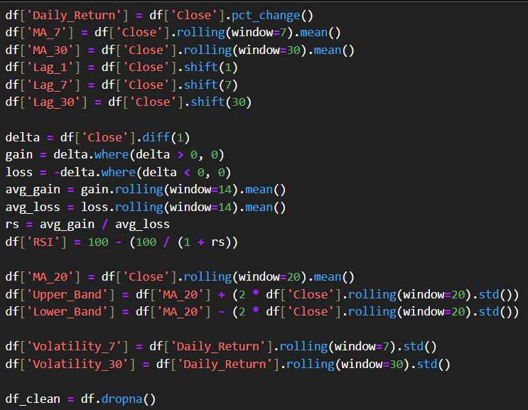
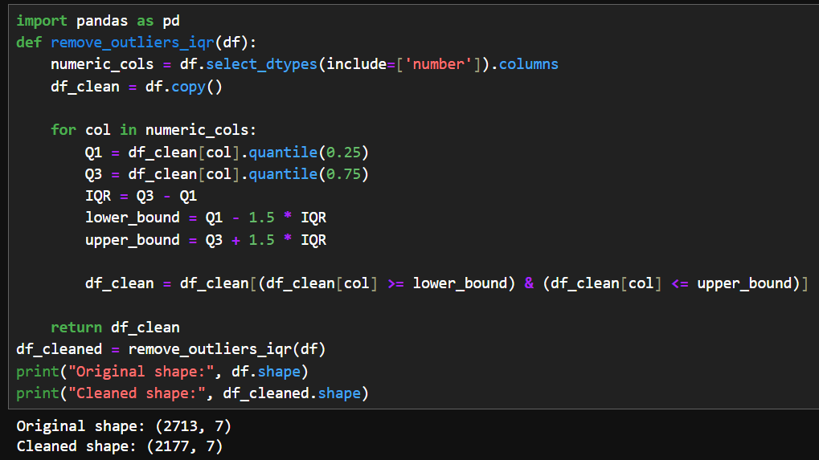
Feature Engineering
Outlier Detection and Removal
01
04
05

Slide 7
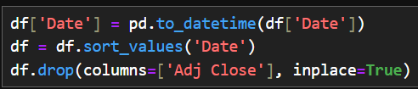
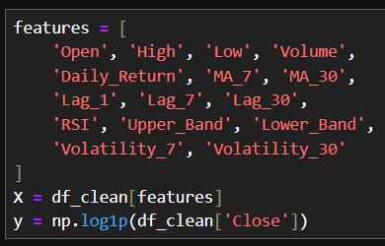
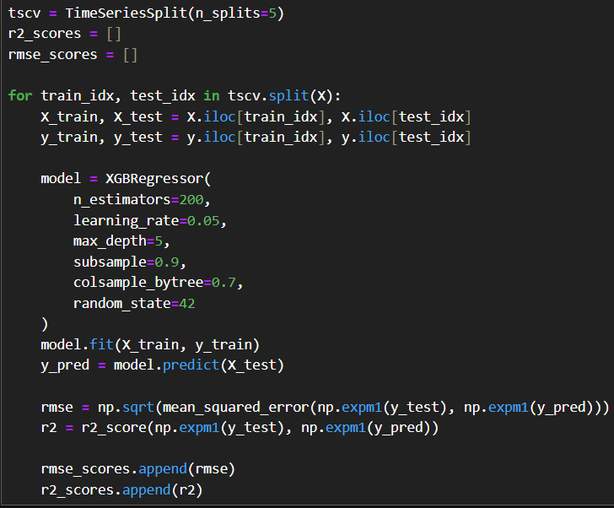
Convert to Datetime Format
Features and Targets
Time Series Cross Validation
01
04
05

Slide 8
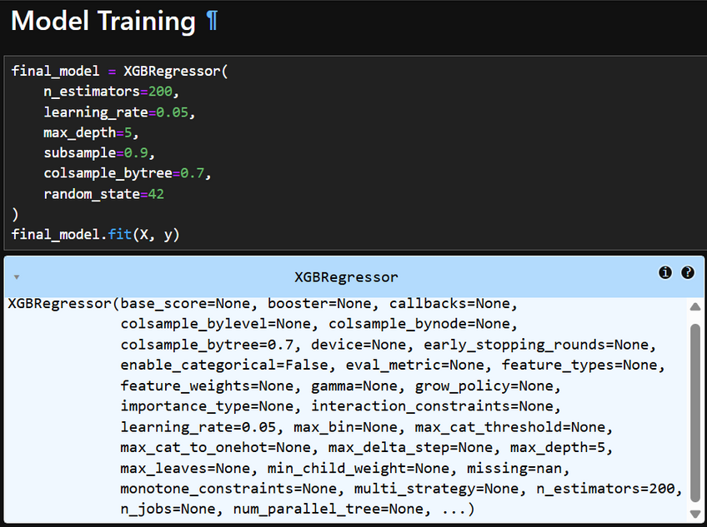
Modeling
For our model we selected XG Boost as it is better for the follwing reasons:
Time series compatibility
Better performance on tabular data
Faster and more scalable
06

Slide 9
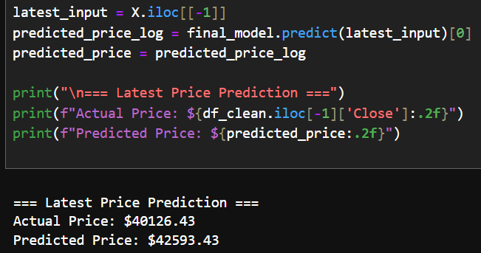
Evaluation
We evalaute and predict the price of the bitcoin using our trained model using XG Boost
The final model shows accuracy of 95 percent
07

Slide 10
Key Findings
Dataset Description:
Historical Bitcoin prices from 2014 to 2022.
Includes typical financial indicators: Open, High, Low, Close, Adj Close, and Volume.
Feature Engineering:
Creation of additional features like rolling averages, returns, and lagged features to capture time-dependent patterns.
Model Used:
The XGBoost Regressor, a powerful tree-based ensemble learning model, was applied for predicting future Bitcoin prices.
Evaluation Method:
Time Series Cross-Validation using TimeSeriesSplit, which is appropriate for chronological data.
Metrics used: Mean Squared Error (MSE), Mean Absolute Error (MAE), and R² Score.
Results:
The model was able to capture trends with decent accuracy (exact metric values will be confirmed below).
Visualization showed that predicted vs actual prices follow similar trends, indicating model effectiveness.
08

Slide 11
Conclusion
Project demonstrates a solid and methodical approach to Bitcoin price forecasting through machine learning
The project successfully implemented a time-series forecasting model for Bitcoin prices using XGBoost.
Careful preprocessing and time-aware validation improved the robustness of predictions.
The use of technical features and lagged variables helped the model understand temporal dependencies.
09

